Slide 1





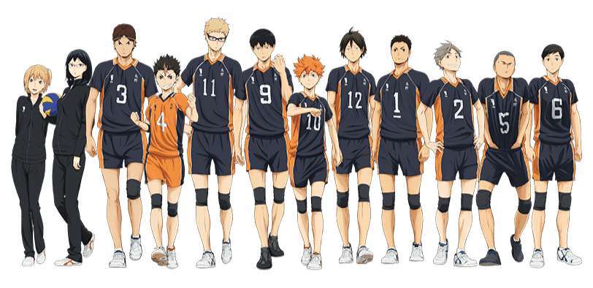




Autobiography

Slide 2
About myself
Title
Name:Erryle Nash Apellido
Age:19
Birthplace:Das Mariñas Cavite
I live:Sipalay City

Slide 3
Title
Hobby
Title
Add text here add text here Add text here add text here
Artistic activities such as painting or graphic design. Community service. Cooking or baking. Examples of interests. Exercising and healthcare. Outdoor activities. Playing an instrument. Team or individual sports.
Online Games.
Click this to see more about my hobby.

Slide 4

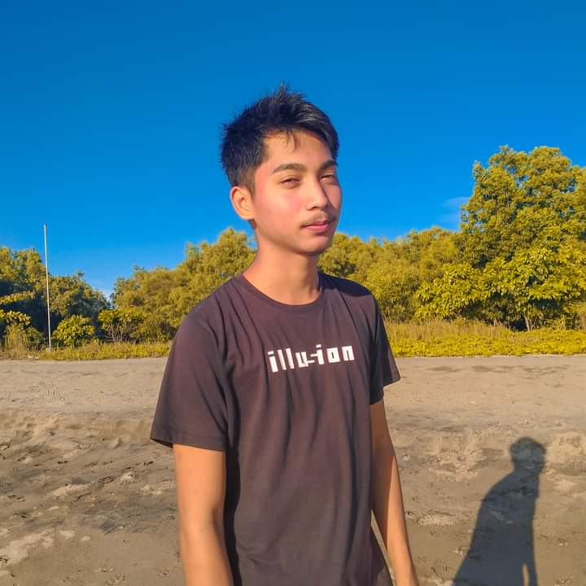
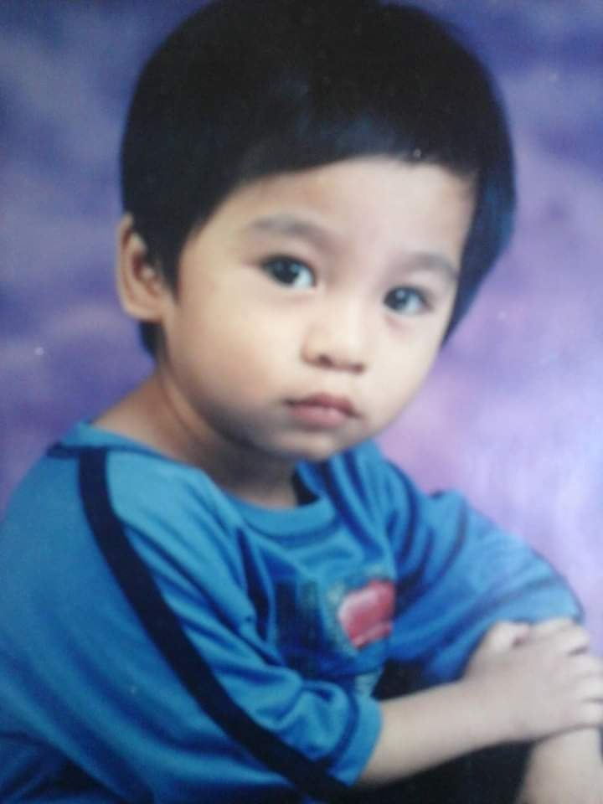
Before and After
Title
Title
Title
Add text here add text here Add text here add text here
Add text here add text here Add text here add text here
Add text here add text here Add text here add text here
Add text here add text here Add text here add text here
Add text here add text here Add text here add text here
Add text here add text here Add text here add text
Add text here add text here Add text here add text here
Add text here add text here Add text here add text here
Add text here add text here Add text here add text here
Add text here add text here Add text here add text here
Add text here add text here Add text here add text here
Add text here add text here Add text here add text

Slide 5
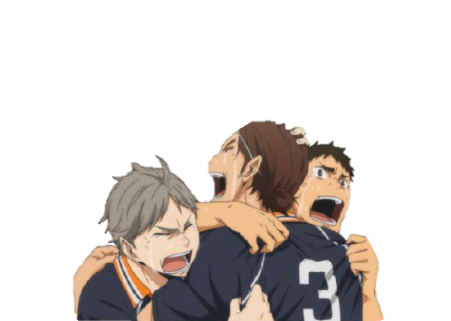
Thank you

